Slide 1

GOVERNMENT COLLEGE OF TECHNOLOGY
COIMBATORE- 641013
ELECTRONICS AND COMMUNICATION ENGINEERING
18LEE708-MINI PROJECT
FINAL REVIEW
SPI IP Design using VERILOG

Slide 2
TEAM MEMBERS LIST
ANTO SANJAY S
GOWTHAM S
KAVINRAJ K
TAMILARASAN M
GUIDED BY
Dr. O. SARANIYA – PROFESSOR (CAS)
COMMITTEE MEMBERS
Dr. P. DEEPA - ASSISTANT PROFESSOR
Dr. G. THIRUGNANAM - ASSOCIATE PROFESSOR (CAS)

Slide 3
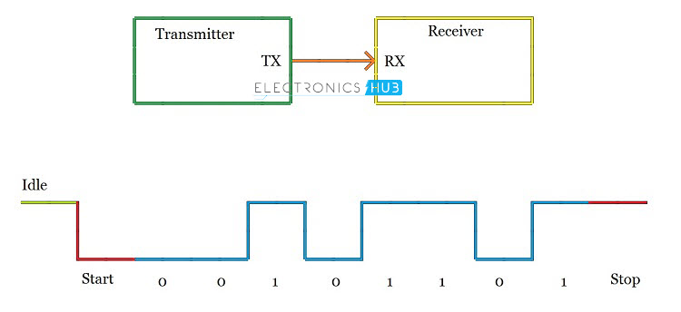
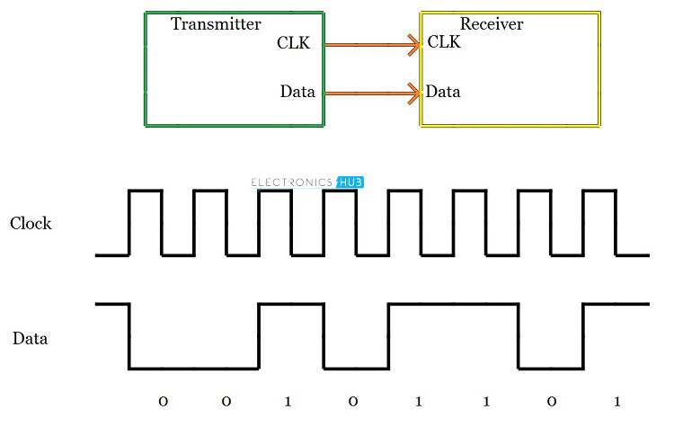
SPI – Serial Peripheral Interface
Serial communication protocols ( UART,I2C,SPI )
Synchronous
Full – duplex communication
Master – slave type protocol
Simple and low cost interface
Short distance communication
UART
I2C
The clock signal must be supplied by the Master to the slave
Two types of triggering mechanisms
1. Level Triggering.
2. Edge Triggering (Mostly Used) – 2 Types.

Slide 4
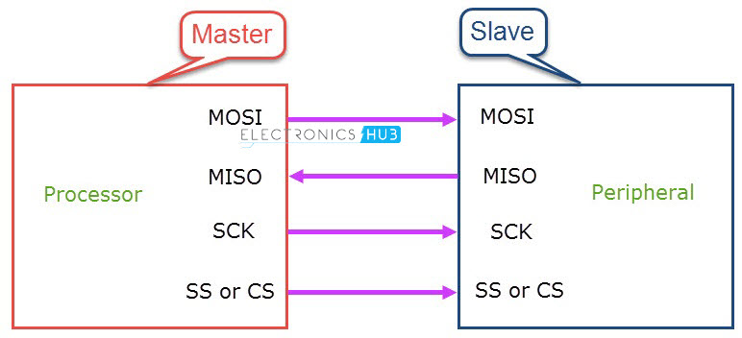
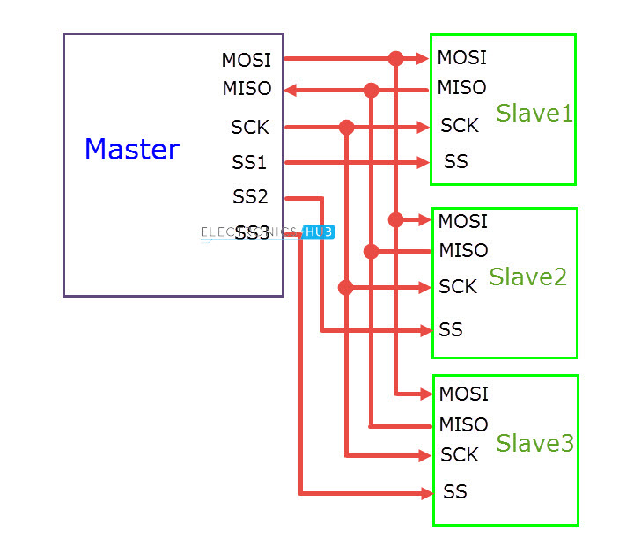
Basic SPI Bus
The SPI bus specifies
Four logic signals:
SCLK: Serial Clock (output from master)
MOSI: Master Out Slave In (data output from master)
MISO: Master In Slave Out (data output from slave)
CS /SS: Chip/Slave Select (often active low, output from master to indicate that data is being sent)
Master with Single Slave
Master with Multiple Slave

Slide 5
Modes of Operation
Clock Polarity determines the state of the clock.
It represents the base value of the clock.
CPOL is High SCK is HIGH during idle and LOW during active state.
CPOL is Low SCK is LOW during idle and HIGH during active state.
Clock Phase determines the clock transition i.e. rising (LOW to HIGH) or falling (HIGH to LOW)
It represents on which edge data to be transmitted.
CPHA is 0, data transmitted on rising edge.
CPHA is 1, data transmitted on falling edge.

Slide 6
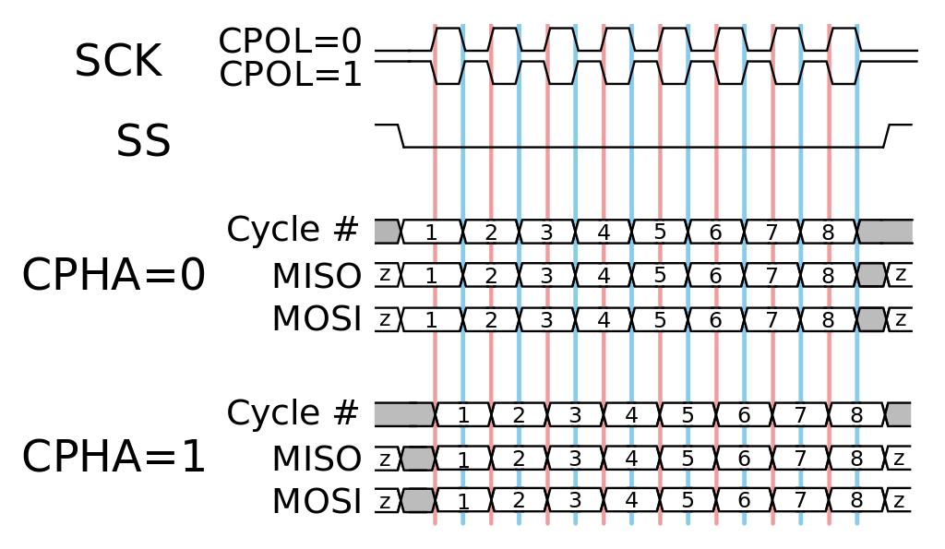
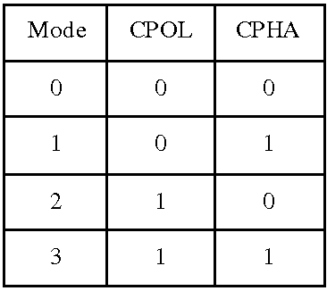
SPI Modes

Slide 7
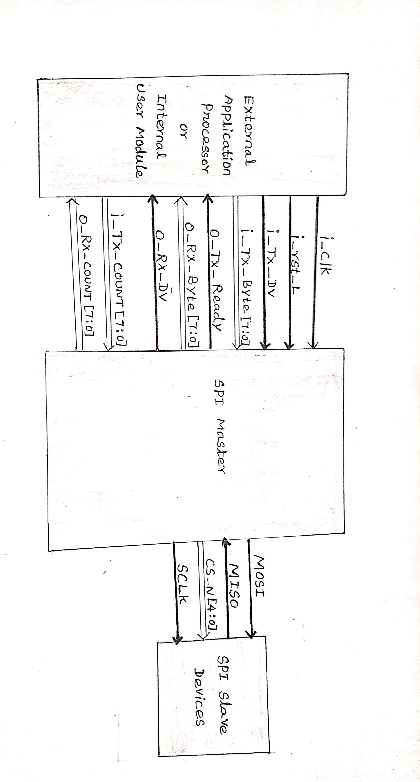
Block Diagram

Slide 8
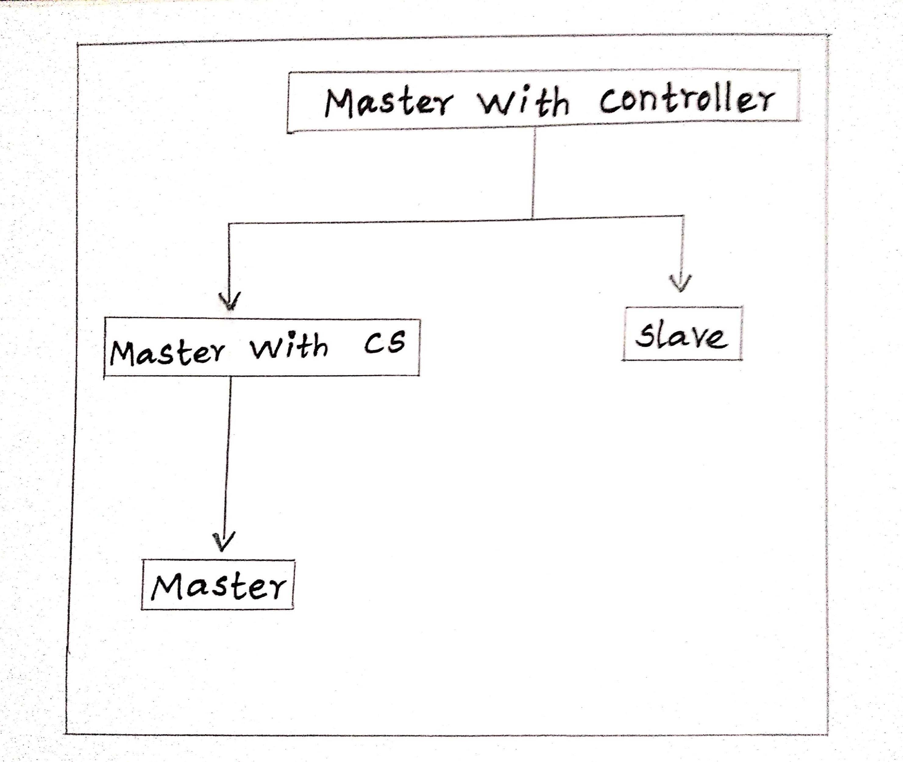
Work Flow

Slide 9
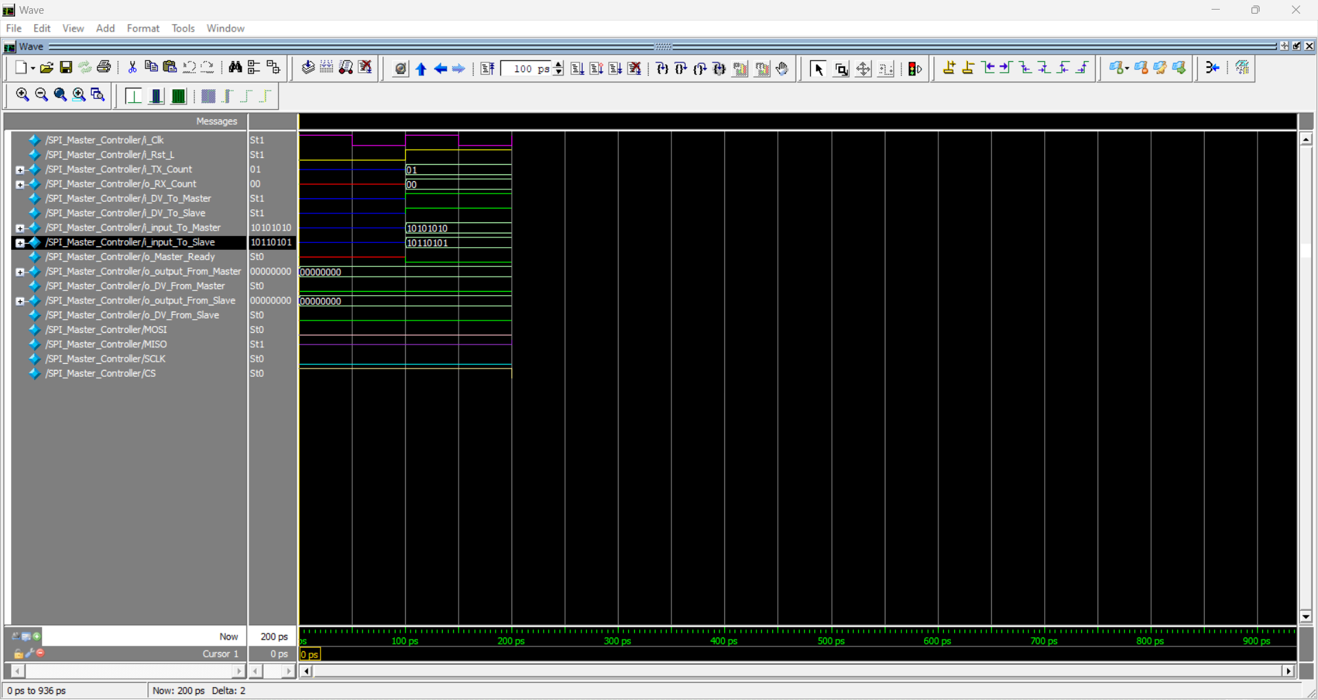
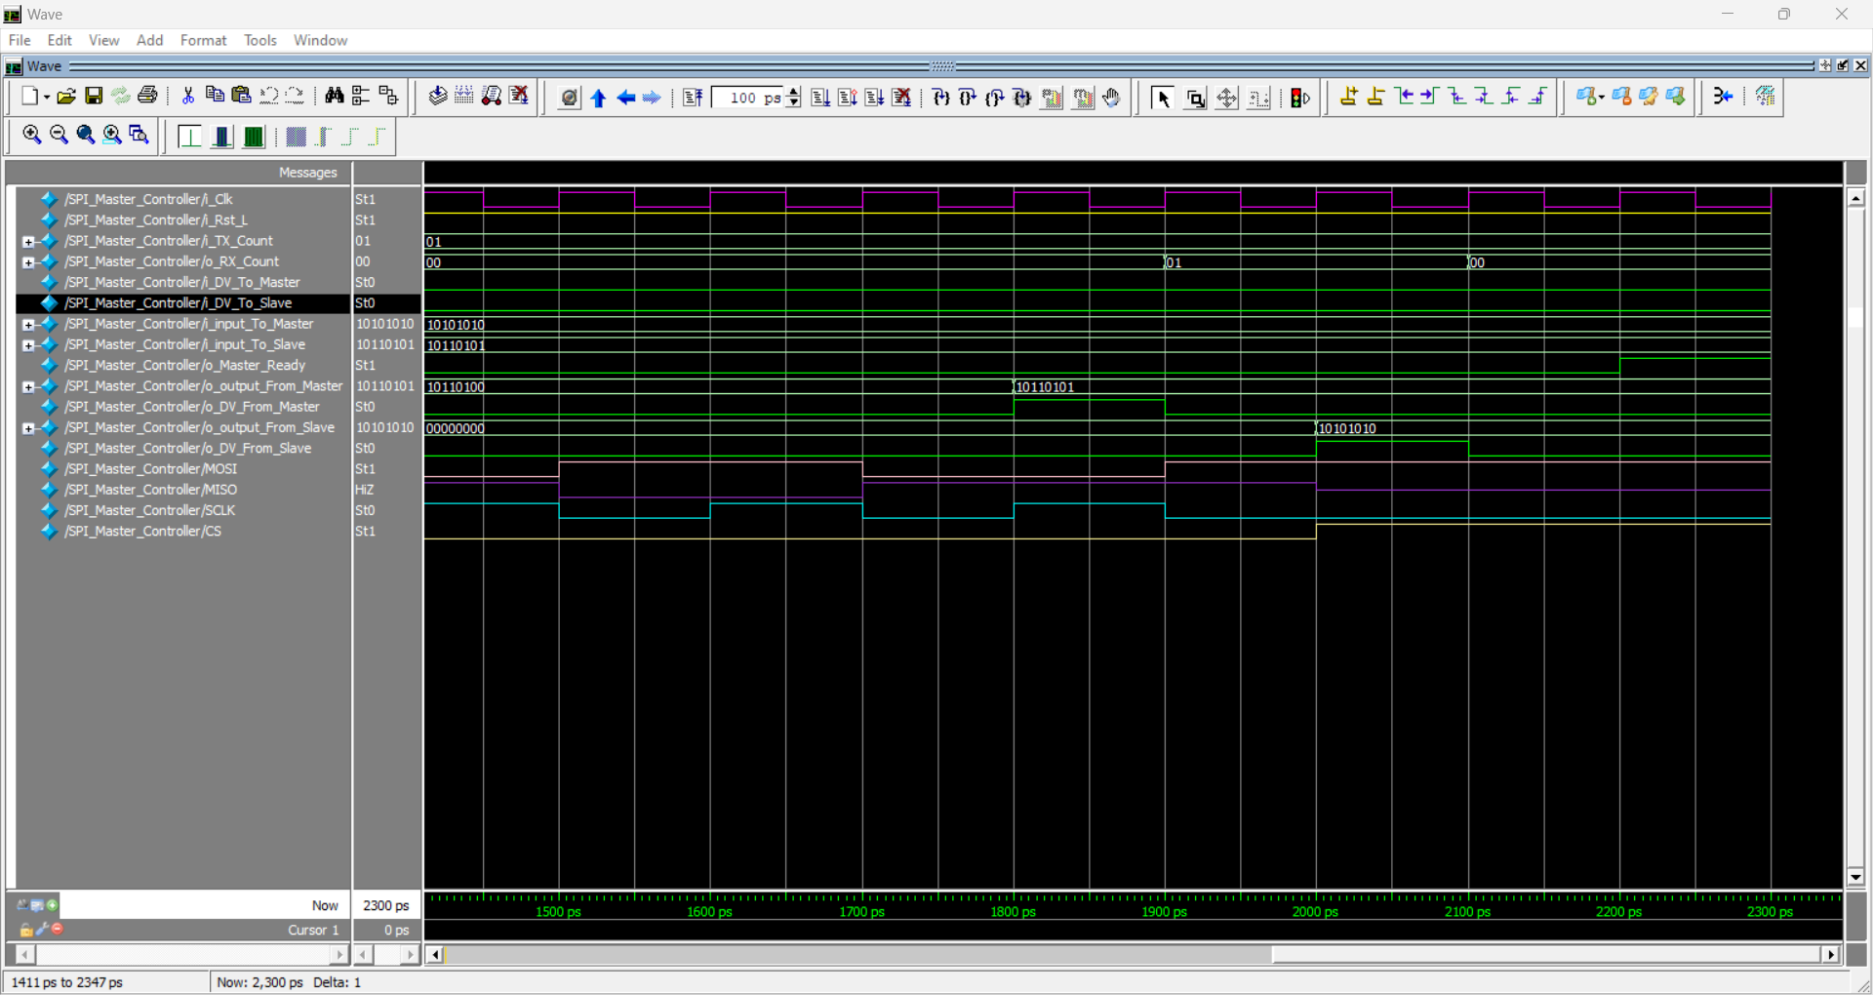
Master – Working (Transmission)
For transmitting the data from the master to the slave, the External Application Processor has to specify the length of the data that is being to be transmitted to the master (in bytes).
The Master accepts a single byte at a time and sends it to the slave bit by bit.
Once a byte is transmitted successfully the EAP sends the next byte to the master.
The EAP also sends a momentary signal called Data Valid along the with the input data to alert the master.

Slide 10
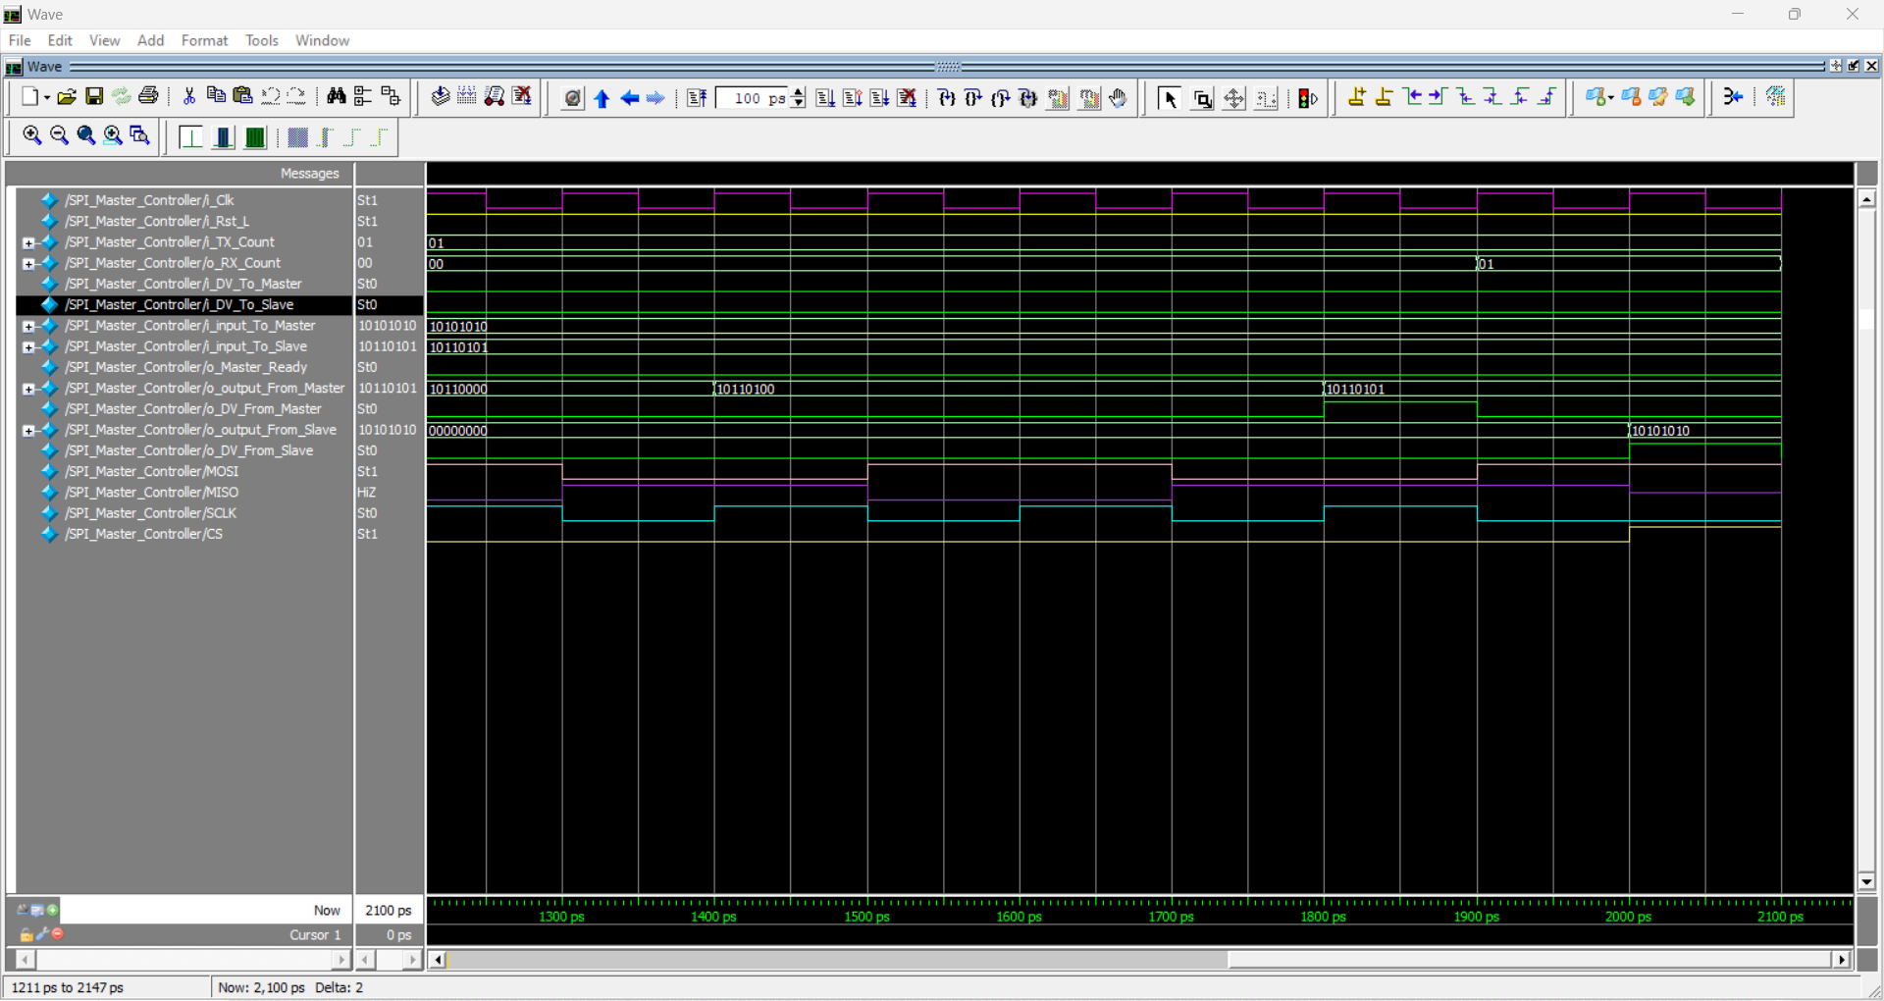
Master – Working (Reception)
The Master also receives data from the slave bit by bit.
The Master collects the bits received from the slave and once 8 bits (1 byte) are collected, it is sent to the EAP.
To alert the EAP that a byte is sent, a momentary signal is sent to the EAP along with the byte.

Slide 11
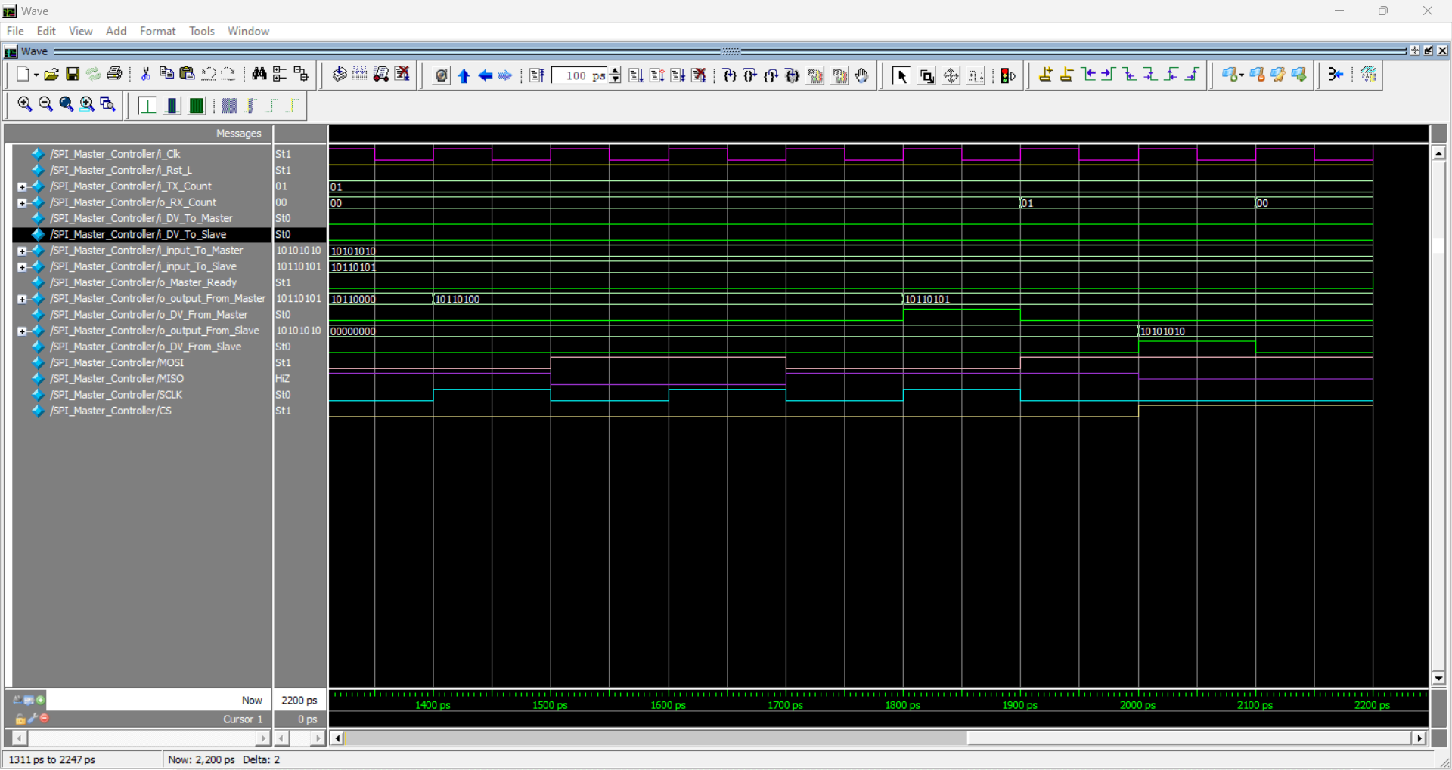
Slave – Working (Transmission and Reception)
The working of Master and Slave are similar.
A byte along with a momentary signal is sent to the Slave which is then transmitted to the Master.
The bits received from the Master is collected and once a byte is collected, it is sent to the External Peripheral which is connected to the corresponding Slave.

Slide 12
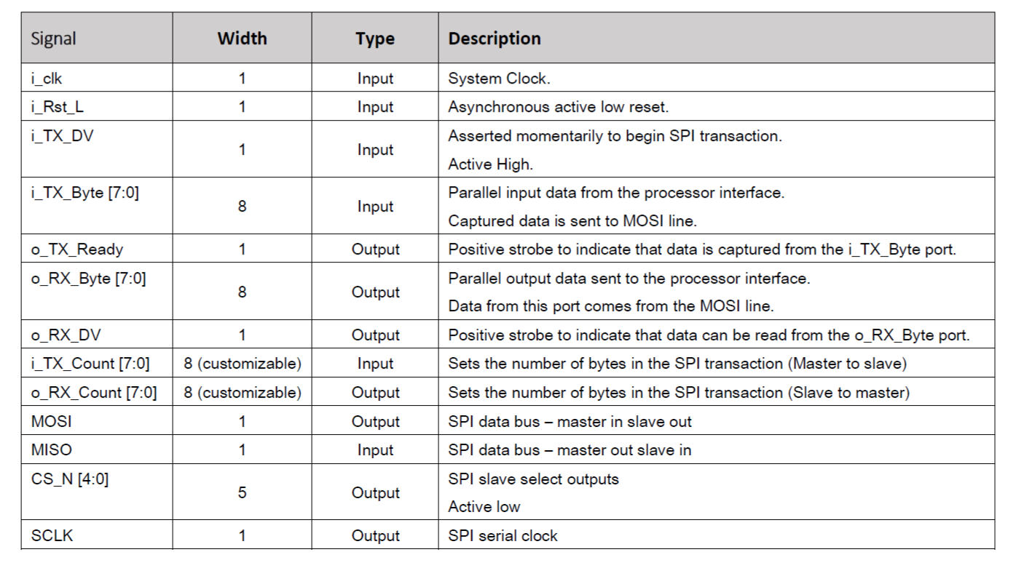
Signal Descriptions

Slide 13
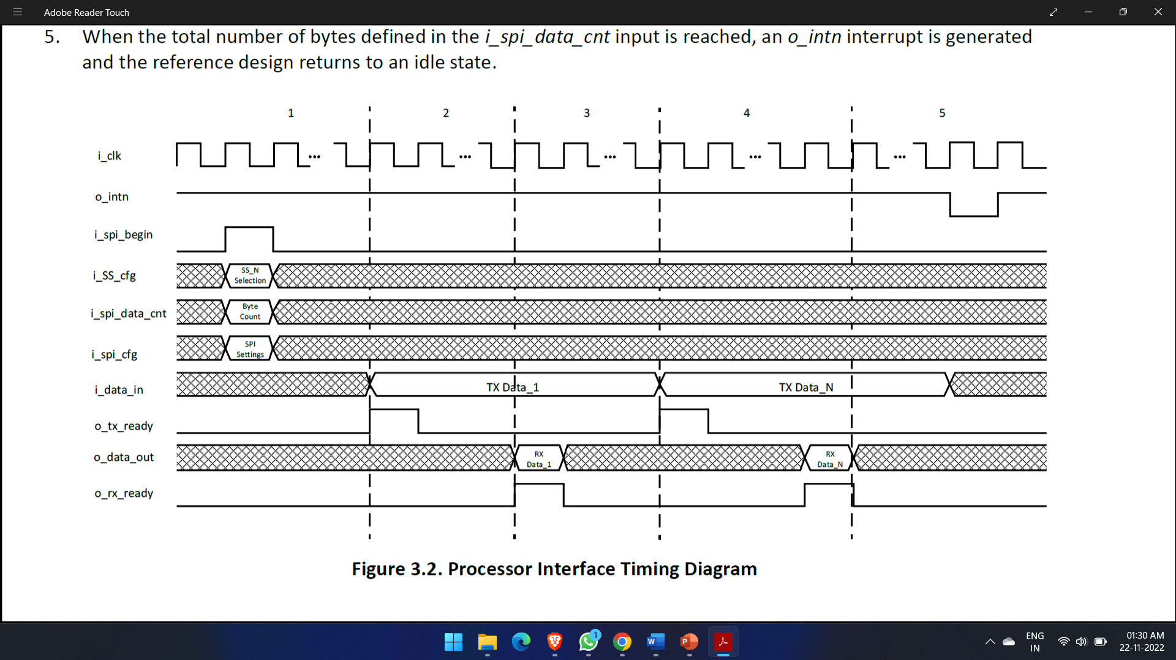
Processor Interface Timing Diagram

Slide 14
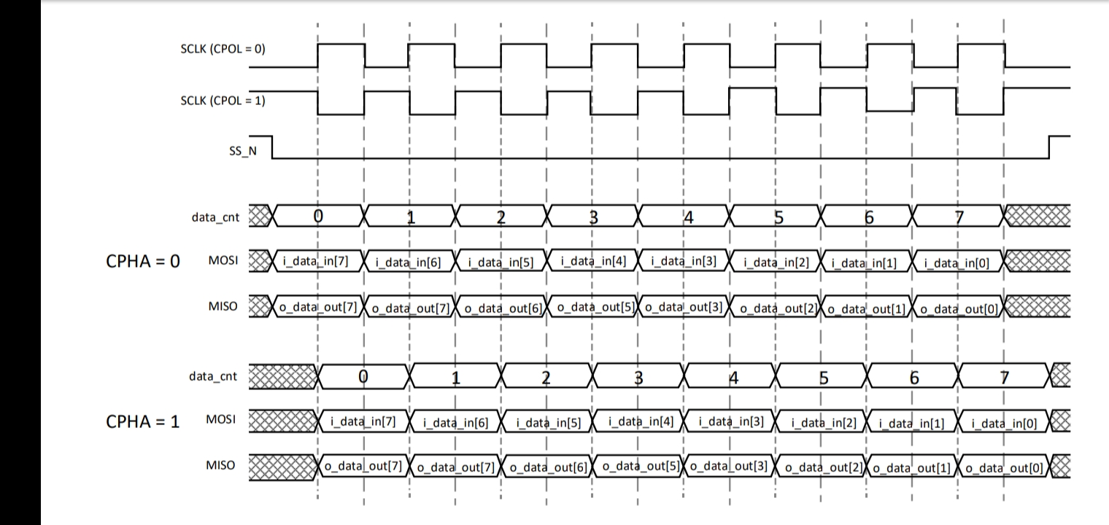
Master-Slave Interface Timing Diagram
6
5
4
6
5
4

Slide 15
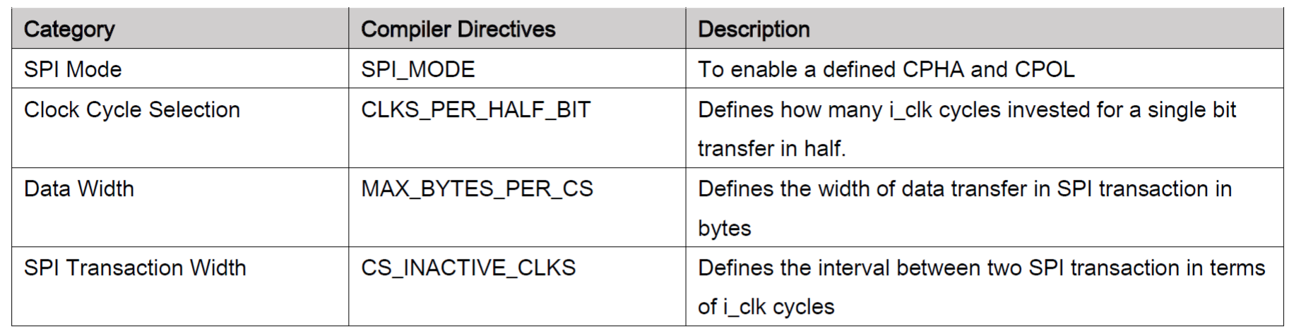
Customization

Slide 16
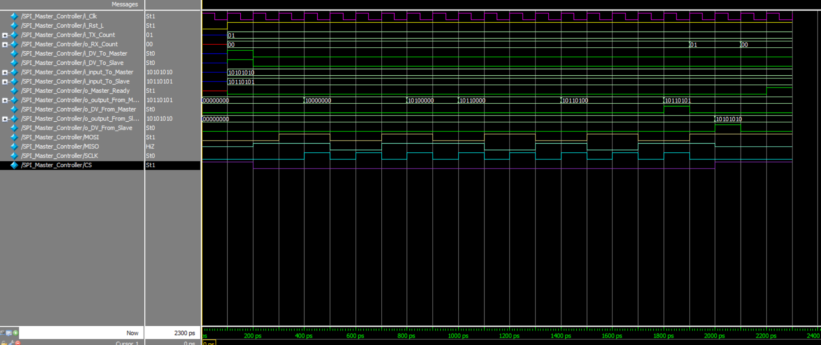
Output – Mode 0

Slide 17
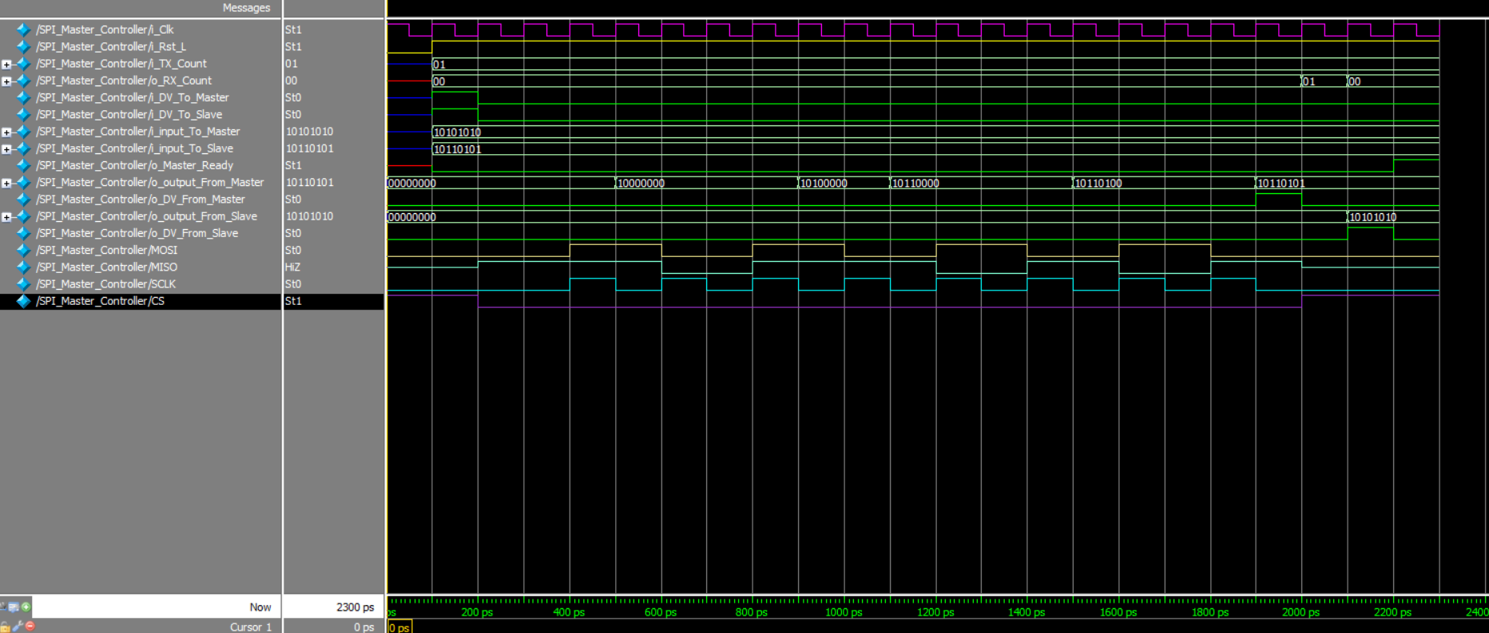
Output – Mode 1

Slide 18
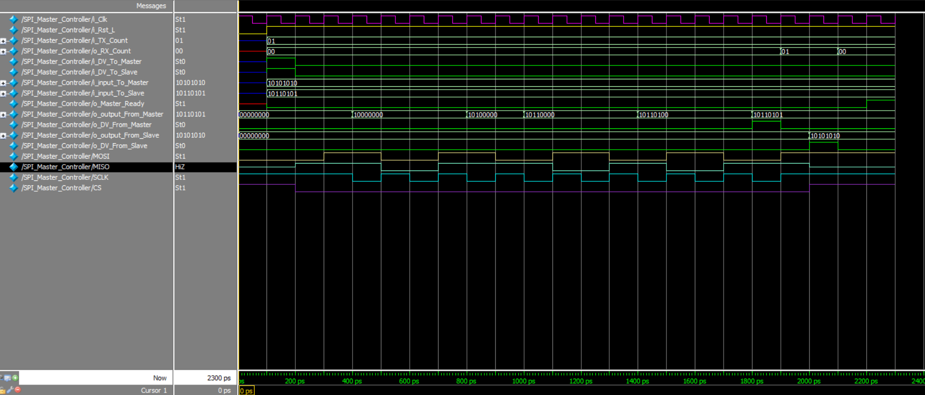
Output – Mode 2

Slide 19

Output – Mode 3

Slide 20
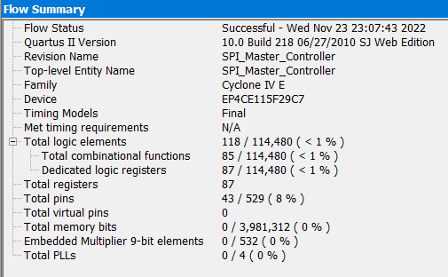
Observation
Data is being transmitted in the ratio 1:2 in terms of i_clk at maximum.

Slide 21
Advantages
Disadvantages
Full duplex
Higher speed than UART (asynchronous), I2C
It Supports Multiple Slaves
Master takes full control of Slave
More pins than UART+I2C
Good at short distances but not good at long distances
No Error Checking Protocol
No acknowledgement for the data sent
There is no flow control by the Slave.
Applications
Memory: SD Card , MMC , EEPROM , Flash
Sensors: Temperature and Pressure
Control Devices: ADC , DAC , digital POTS and Audio Codec.
Others: Camera Lens Mount, touchscreen, LCD, RTC, video game controller, etc.

Slide 22
Code
https://github.com/Gowthamsiva1506/SPI-IP-Design-using-Verilog

Slide 23
References
Yong Guo, Yubo Wang, Xiaoke Tang, 2020, “A SPI Interface Module Verification Method Based on UVM”, IEEE.
Orhan Gazi & A. Çağrı Arlı, 2021, “Serial Peripheral Interface. In: State Machines using VHDL” Springer, Cham.
https://en.wikipedia.org/wiki/Serial_Peripheral_Interface
https://www.cinterviewtips.com/p/spi-interview-questions.html?m=1
https://aticleworld.com/difference-between-i2c-and-spi/
Hafeez, M., & Saparon, A. (2019). IP Core of Serial Peripheral Interface (SPI) with AMBA APB Interface. 2019 IEEE 9th Symposium on Computer Applications & Industrial Electronics (ISCAIE). doi:10.1109/iscaie.2019.8743871
https://ieeexplore.ieee.org/document/8743871
https://www.google.com/url?sa=t&source=web&rct=j&url=https://www.latticesemi.com/products/designsoftwareandip/intellectualproperty/referencedesigns
Dawoud Shenouda Dawoud, Peter Dawoud, 2020, “Serial Peripheral Interface (SPI),” IEEE, River Publishers, 191 – 244.

Slide 24
THANK YOU

